Slide 1
Catalyzing Change in
High School Mathematics: Initiating Critical Conversations

Slide 2
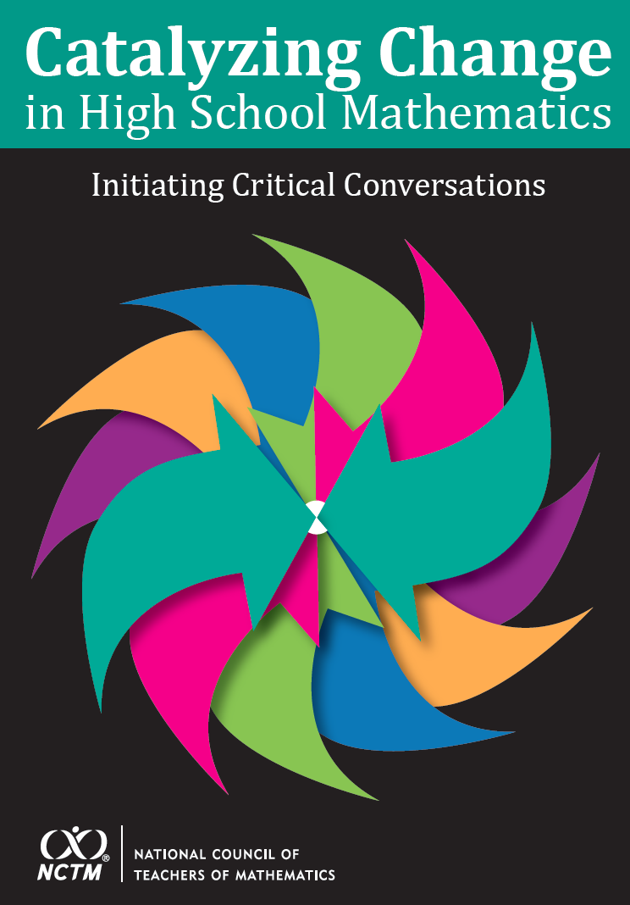
Purpose
Explicitly broaden the purposes for teaching high school mathematics.
Initiate discussions of the challenges as well as recommendations & actions to overcome those challenges.
Define equitable structures, instructional practices, and pathways for students.
Identify Essential Concepts for focus that all students should learn and understand at a deep level.

Slide 3
Key Recommendations
Each and every student should learn Essential Concepts in order to expand professional opportunities, understand and critique the world, and experience the joy, wonder, and beauty of mathematics.
High school mathematics should discontinue the practice of tracking teachers as well as the practice of tracking students into qualitatively different or dead-end course pathways.

Slide 4
Key Recommendations
Classroom instruction should be consistent with research-informed and equitable teaching practices.
High schools should offer continuous four-year mathematics pathways with mathematics studied each year, including a common pathway shared by all students focusing on the Essential Concepts, to ensure the highest-quality mathematics education for all students.

Slide 5
Catalyzing Change Rollout
Advanced sales with pickup at the Annual Meeting – D.C. – April 25-28.
Opening Content Sessions – Thursday 8-9 a.m.
  Matt Larson – Overview Catalyzing Change
  Peg Smith – Taking Action Series
  Dorothy White and Sylvia Celedón-Pattichis – Access and Equity (Focus on Equity Series_

Slide 6
Catalyzing Change:
Supporting Conversations and Change
Expanded content /resources online similar to PtA (More4U)
Support and use discussions-resources in MyNCTM.
Professional development and additional publications / activities under design/development.

