Slide 1
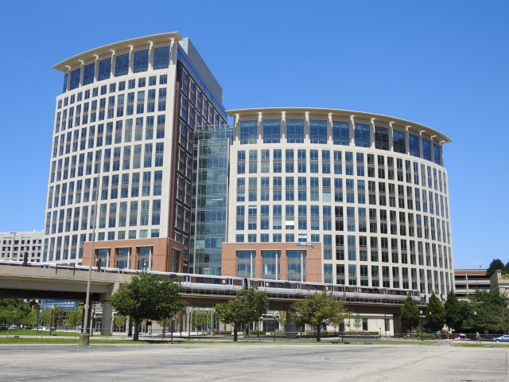
National Science Foundation Update
Jim Lewis
Acting Assistant Director
Education and Human Resources

Slide 2
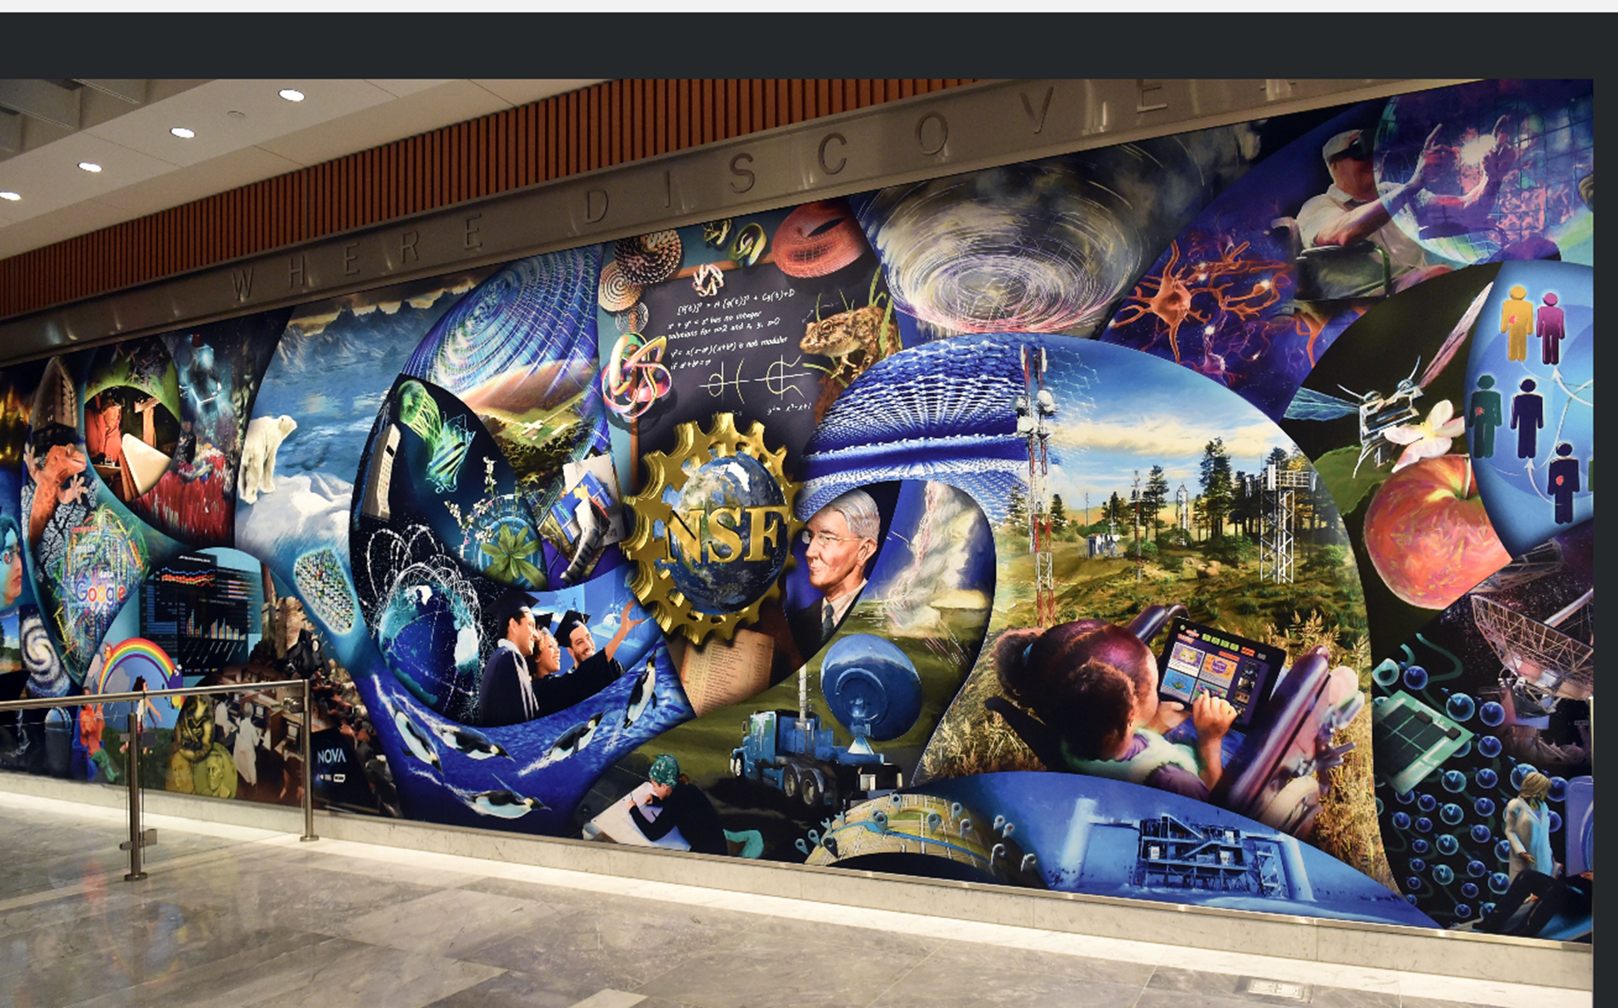
National Science Foundation Update
Jim Lewis
Acting Assistant Director
Education and Human Resources

Slide 3
Budget Uncertainty
 | FY17 Approp. | FY18 Request | FY18 House Senate
NSF | $7.96B | $6.65B | $7.33B $7.31B
EHR | $880.00M | $760.55M | $880.00M $862.40M
* Continuing Resolution to December 8, 2017
National Science Foundation

Slide 4
National Search for Assistant Director for Education and Human Resources
Seeking strong list of outstanding candidates
Notice posted November 28, 2017
Nomination deadline January 22, 2018
http://www.nsf.gov/od
National Science Foundation

Slide 5
Funding in EHR Over Time
National Science Foundation

Slide 6
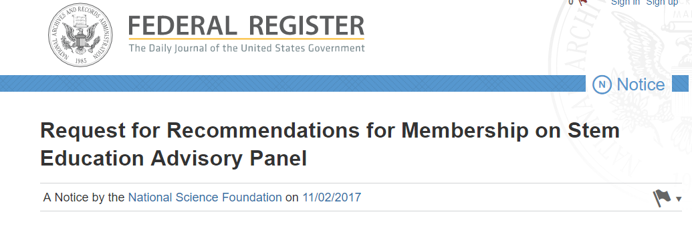
Request for Recommendations for Membership on STEM Education Advisory Panel
STEM Education Advisory Panel established
October 18, 2017
Currently accepting recommendations (Target date November 30, 2017)
National Science Foundation

Slide 7
Establishing an HSI Program
NSF announces plans for Hispanic Serving Institution Program – June 6, 2017
Goals to establish the program:
  Build capacity at Hispanic Serving Institutions
  Focus on undergraduate HSIs
A Subcommittee of our Advisory Committee comprised of HSI campus leaders provided advice regarding the solicitation.
Dear Colleague Letter to fund conferences
Solicitation Released today (NSF 18-524)
National Science Foundation

Slide 8
HSI Conference Awards
University of Arizona – November 18-20, 2017 Transforming STEM Education in Hispanic Serving Institutions - Regional Insights from the Southwest
Nova Southeastern University, FL – December 11-12, 2017 Hispanic-focused STEM Ideas for Inspiration and Innovation
University of California-Irvine – January 22-24, 2018 Pathways for Hispanic Students in STEM
University of Houston – February 16-18, 2018 Understanding and Improving Readiness and Student Transitions
Additional submissions received September 30, 2017
National Science Foundation

Slide 9

http://www.nsf.gov/news/special_reports/big_ideas
National Science Foundation

Slide 10



Big Ideas
Harnessing Data for 21st Century Science and Engineering
Understanding the Rules of Life: Predicting Phenotype
The Quantum Leap: Leading the Next Quantum Revolution
National Science Foundation

Slide 11


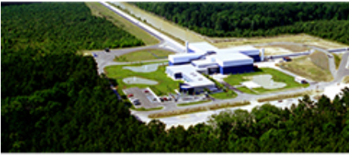

Big Ideas
The Future of Work at the Human-Technology Frontier
Navigating the New Arctic
Windows on the Universe: The Era of Multi-Messenger Astrophysics
National Science Foundation

Slide 12



Big Ideas
Process Ideas
Growing Convergent Research at NSF
Mid-Scale Research Infrastructure
NSF 2026: Seeding Innovation
National Science Foundation

Slide 13
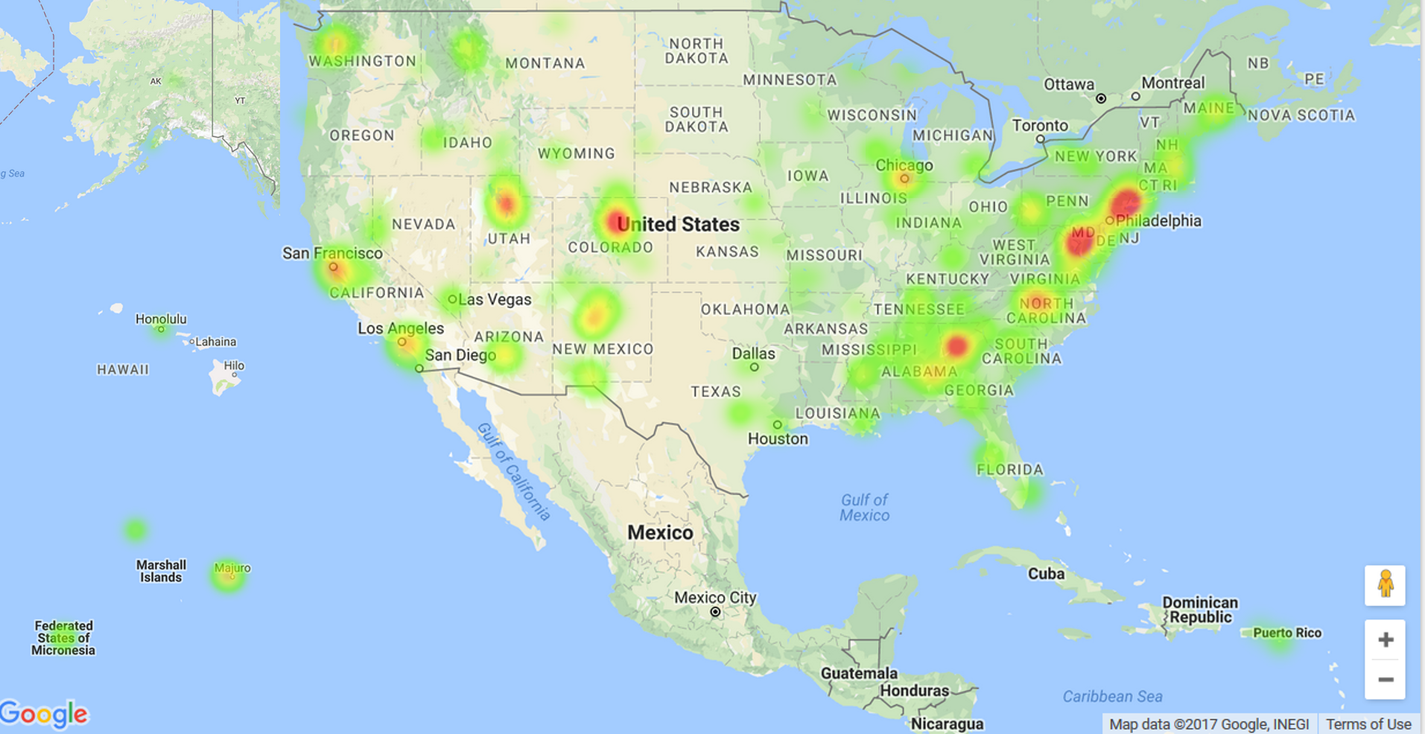

NSF INCLUDES
67
Launch Pilots Funded

Slide 14







Launch Pilot Strategies
to address a particular broadening participation challenge
provide STEM engagement for students and communities to promote STEM studies and careers
enhance support systems for undergraduate and graduate STEM students
?
address students’ STEM identity, attitudes, motivation
strengthen institutional capacity
prepare STEM educators
expand access to quality STEM education
address career needs of STEM professionals
5
projects
6
projects
9
projects
10
projects
11
projects
20
projects
39
projects
Note: Some projects have goals and objectives that fall into more than one category.
Image credits: Clker.com

Slide 15
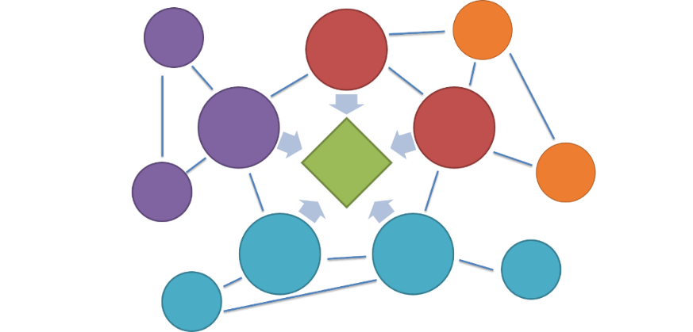
NSF INCLUDES IN FY 2018
On-Ramps
DCL NSF 17-111
Coordination Hub
Alliances
(coming soon)
Launch Pilots from FY16 & FY 17

Slide 16
Best Opportunities for Mathematics
Improving Undergraduate STEM Education (IUSE)
Robert Noyce Teacher Scholarship Program (NOYCE)
Discovery Research PreK-12 (DRK-12)
NSF Scholarships in Science, Technology, Engineering, and Mathematics (S-STEM)
Advanced Technological Education (ATE)
Graduate Research Fellowships Program (GRFP)
National Science Foundation

Slide 17
Why Not?
NSF INCLUDES
Hispanic Serving Institutions (HSI) Program
Historically Black Colleges and Universities Undergraduate Program (HBCU-UP)
Louis Stokes Alliances for Minority Participation (LSAMP)
ADVANCE: Increasing the Participation and Advancement of Women in Academic Science and Engineering Careers
EHR Core Research (ECR)
National Science Foundation Research Traineeship (NRT) Program
National Science Foundation

Slide 18
NSF Perspective
EHR seeks proposals that will make a unique contribution to mathematics education.
We are looking for new, innovative ways to push the field forward – to address the challenges of improving undergraduate and graduate mathematics education.
Write more proposals.
National Science Foundation

Slide 19
What’s New?
No submission deadline for the IUSE:EHR Exploration & Design (up to $300K) proposals in FY2018 and FY2019
National Science Foundation

Slide 20
DISCUSSION
National Science Foundation

Slide 21
IUSE: EHR
IUSE: EHR is a broad program focused on improving undergraduate STEM education
  For all types of institutions of higher education.
  For all aspects of undergraduate STEM education.
    This includes pre-service education for future K-12 teachers of any STEM discipline.
National Science Foundation

Slide 22
Engaged Student Learning (ESL) Projects
Focus on design, development, and research studies.
Involve the creation, exploration, or implementation of tools, resources, and models that show promise to:
  increase engagement in STEM learning; and
  lead to measurable and lasting learning gains.
Reflect disciplinary differences in needs and priorities.
National Science Foundation

Slide 23


IUSE: EHR and ATE (S-STEM) Example:
“Progress through Calculus”
Principle Investigator: David Bressoud
Mathematical Association of America
National Science Foundation

Slide 24
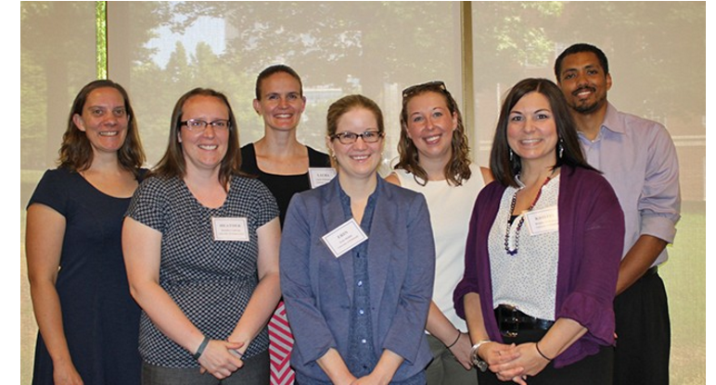
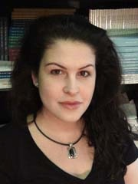
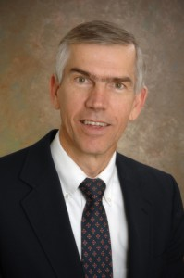
ECR Program Example:
“Understanding the Effects of Mathematics Teacher Preparation on the Quality of Classroom Teaching and Students' Learning”
Dawn Berk and Jim Hiebert
University of Delaware
National Science Foundation

