Slide 1
Report from USNC/MI
CBMS Meeting, December 2017
U.S. National Commission on Mathematics Instruction
Notes:
The aim of this presentation is to provide you with information about the United States Commission on Mathematics Instruction its collaborative role in international mathematics education, global outreach and partnerships.

Slide 2
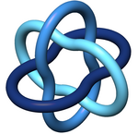


Alphabet Soup
International Mathematical Union (IMU)
International Commission on Mathematical Instruction (ICMI)
United States Adhering Organization – National Academies
  Policy and Global Affairs Program Unit (PGA)
    Board on International Scientific Organizations (BISO)
      U.S. National Commission on Mathematics Instruction
      (USNC/MI)
Notes:
Some may not know much about the commission.
Alphabet Soup
International Mathematical Union, 1919, Felix Klein first president
International Commission on Mathematical Instruction, 1908, reconstituted 1952 as a commission of the IMU
Countries are members 92 ICMI, 70 IMU
US adhering organization is the National Academies > Policy and Global Affairs Policy Unit > Board on International Scientific Organizations (BISO) > U.S. National Commission on Mathematics Instruction (USNC/MI)
No US representation on ICMI, our nominee was not elected at the General Assembly meeting in Hamburg

Slide 3
Functions of USNC/MI
Also. . .
Support efforts to build strong international collaborations in areas of interest to U.S. mathematics educators
Disseminate information in the United States about mathematical sciences education in other countries
Stimulate research studies and reports on comparative mathematics education
Foster outreach to other countries and provide information about U.S. mathematical sciences education;
Encourage regional and national meetings addressing international issues that affect the U.S.
Serve as liaising body between U.S. and ICMI
Represent U.S. at ICMI General Assembly (at the International Congress on Mathematical Education- ICME)
Participate in ICMI activities
  Candidates for Exec committee, awards committee, ICME program committee, ICMI studies
  Disseminate study findings
Establish strong U.S. interactions with ICMI, including support U.S. participation in ICME
Notes:
As such, our primary function is to liaise with ICMI. This is done through a variety of activities.1) sending reps to the General Assembly meeting at ICME. 2) proposing candidates for the EC, award committees and awards, IPCs for ICME or for the ICMI studies. 3) following and disseminating the results of ICMI studies. I don't know exactly what our role has been in the past regarding participation in ICMI Study Conferences, but we have added some funding to send a participant in the next round of funding. 4) cooperating on the travel grant program to ICME. The main route of dissemination in the past has been to offer several presentations at the NCTM national meeting, on ICMI studies, on ICME, on the Klein and Freudenthal awards, the Klein Project, and other things

Slide 4
Current USNC/MI Members
James Roznowski, Chair
John Staley, Vice chair
James Barta
Marta Civil
Solomon Friedberg
Maria Hernandez
Deborah Nolan
Christopher Rasmussen
Padmanabhan Seshaiyer
Ex-officio members
Gail Burrill, past chair
Patrick Scott, BISO Liaison
John Hildebrand, NAS foreign sec.
Donald Saari, Chair, NRC BMSA
Notes:
Mention that nominations for membership come from CBMS, NCTM, or USNC/MI but the appointments are individual and the members do not represent specific organizations.

Slide 5
2018 Nominations
At least one, maybe two, nominations from CBMS for four-year appointments beginning January 2019
Process
  USNC/MI Chair provides list of desired background for candidates
  CBMS Chair requests suggestions from presidents of member societies
  Names received are submitted to CBMS’ Nominating Committee
  CBMS Chair contacts each person to see if they would be willing to serve if eventually appointed by NAS
  CBMS forwards list of nominees and alternates to BISO
Notes:
This is according to a agreement revised January 29, 2010.
I can provide David Bressoud with a copy if he needs it.
Mention the possibility that USNC/MI Operating Procedures might change, and additional nominees may be requested.

Slide 6
Recent USNC/MI ACTIVITIES
Finland Report
  Post ICME-13 Workshop, August 1-2
  University of Helsinki
  15 American and 15 Finnish educators, and virtual participants
Award Nominations:
  Felix Klein Award (lifetime achievement): James Hiebert
  Hans Freudenthal Award (research program): Deborah Loewenberg Ball
  Awards given in 2019
Notes:
Report from the Finland workshop has been finalized and will soon be available.
Stress that these were just nominations. Not sure when the awards will be announced but the ICMI website has the awards given in 2011, 2015, etc.

Slide 7
Recent USNC/MI ACTIVITIES
Park City Mathematics Institute 2017
  First week of July
  Participants: Czech Republic, Guatemala, Nigeria, Philippines, Spain, United States
  Topic: Probability
See USNC/MI website for activities and events
  http://sites.nationalacademies.org/PGA/biso/ICMI
Notes:
Park City 2017 held in Utah the week of July 4th.

Slide 8
Proposed USNC/MI Activities
Park City Mathematics Institute
Support for US representatives on ICMI Groups
  ICMI Study 24: School Mathematics Curriculum Reforms: Challenges and Changes
  ICME-14 International Program Committee
Post ICME-14 Workshop with teachers from Singapore
Wider dissemination of USNC/MI initiatives with YOUR help.
  Thanks to: AMS, ASSM, NCTM, SIAM
Notes:
They should know that our NSF grant proposal was not funded. It has been resubmitted and we hope that it will fund the activities listed.
Encourage help from the associations to promote our work. It could be anything from links on their website to our page, space in newsletters, presentation slots at conferences, etc. I have listed the organizations that have already said they would help. Apologize if I forgot anyone.

Slide 9
Letter of Concern regarding Supplemental Questions for VISA applications (May 18, 2017)
American Mathematical Society
American Statistical Society
Association for Women in Mathematics
Conference Board of the Mathematical Sciences
Institute for Operations Research and the Management Sciences
Institute of Mathematical Statistics
National Association of Mathematicians
National Council of Teachers of Mathematics
Society for Industrial and Applied Mathematics
TODOS: Math for ALL
THANKS!
Notes:
Thank the listed associations for their support in a letter from the Academies to the State Department. Apologize if I missed anyone.

Slide 10
ICME-13 U.S. Reception
American Mathematical Association of Two-Year Colleges
American Statistical Society
Association of Mathematics Teacher Educators
Conference Board of the Mathematical Sciences
Mathematics Association of America
National Council of Supervisors of Mathematics
National Council of Teachers of Mathematics
THANKS!
Notes:
Thank the listed associations for their support of the reception. One hundred forty mathematics educators attended, including the members of Executive Committee of International Mathematics Union and members of ICMI.

Slide 11
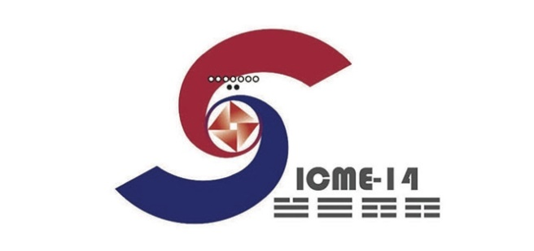
International Committee on Mathematical Instruction
ICME-14
  July 12-19, 2020 - Shanghai, China
  Marta Civil and Daniel Chazen, Members of the International Program Committee
ICME-15
  ICMI Study 24
    School Mathematics Curriculum Reforms: Challenges and Changes
    Al Cuoco, Member of the Study Team
  Donation of Books and Libraries
    Contact ICMI Secretary General, Abraham Arcavi, abraham.arcavi@weizmann.ac.il
Notes:
Mention Hawai’I bid. If we want to have an ICME in US we will need support (financial) from professional organizations. Could be the start of a discussion. ICME-15 (2024) Intention to Bid proposals were due December 1, 2017. We don’t believe anyone from US is planning on bidding.

Slide 12
Questions / comments

