Slide 1

Mathematical Sciences Education Board
Jennifer Heimberg
Acting Associate Board Director
Kerry Brenner
Senior Program Officer
Board on Science Education
May 2, 2025
CBMS Meeting
American Mathematical Society, Washington DC

Slide 2
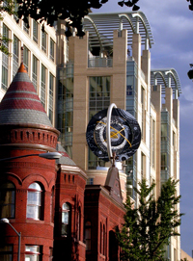
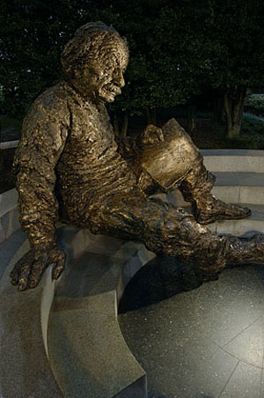



The National Academies
A nonpartisan, nongovernmental organization (NGO) founded in 1863
Honorific arm & operational arm
  Bring together committees of experts in all areas of scientific and technological endeavor
  Address critical national issues and give advice to the federal government and the nation
  Serve as a connection point between research, policy, and practice
NATIONAL ACADEMY OF MEDICINE
Notes:
Introduce the National Academies
Recognize honorific arm of the institution (with labels below) then dive into the operational arm, where studies and projects make use of the nation’s experts including Academies members
Kerry
Talk about committees of volunteers

Slide 3

Division of Behavioral and Social Sciences and Education (DBASSE)
Division on Earth and Life Studies
Division on Engineering and Physical Sciences (DEPS)
Gulf Research Program
Health and Medicine Division
Policy and Global Affairs
BOSE
Board on Science Education
Mathematical educators and education researchers
MSEB
Mathematical Sciences Education Board
BMSA
Board on Mathematical Sciences and Analytics
Prominent mathematicians and practitioners
Notes:
The operational arm is organized into divisions, most of which are listed here.
Each division hosts a variety of boards whose scientific topics fall largely within the division.
Boards serve as entities that identify and develop projects that convene experts to address specific challenges or topics. Projects include consensus studies or workshops.
The MSEB makes use of two existing boards which are hosted by two divisions. BOSE and BMSA collaborate with MSEB staff in developing a wider sponsor base, expertise, and ideas. We are extremely thankful for their contributions and advice to Kerry and me, as we developed the member slate for the MSEB.

Slide 4

Mathematical Sciences Education Board (MSEB): mission and scope
Through its activities and projects, the MSEB brings together experts in mathematical research and education to provide national-level guidance for the future of U.S. mathematical education for all students.
Scope: preK-12 through postsecondary
Organization of the board:
Balanced between mathematical education and mathematical research experts
Two cochairs
16 members (to start)
Formation and one meeting in Year 1; two meetings per year in Years 2 and 3; possible expansion of the board by up to 4 additional members
DEPSCom Meeting March 2025
Notes:
And there is a lot of interest!
We are working hard to identify the right mix of “math ed curious” mathematicians and similarly “math research interested” math educators. Much work has been done to collect evidence for specific teaching practices, including reports from the National Academies.
Once formed the board will have a potential consensus report, complete with interested sponsors, to review and adapt as they see fit. The idea for the MSEB to develop a Grades 9 -14 framework comes from the widely popular BOSE report, “A Framework for K-12 Science Education” from 2012.
Depending on how the recent actions to reduce the Education Department pan out, the MSEB may decide to step in to address some of the topics and projects that the Education Department led including highlighting the need for the NCES, examining accessibility of math ed and math research options for those with disabilities, and even step-up another NMAP.

Slide 5
MSEB: brief history and current status
Years-long efforts to reestablish the MSEB through outreach and coordination with many societies and experts to raise awareness and gather ideas.
November 2024: Funding received from the Gates Foundation
January 2025: Call For Experts open for the entire month, resulting in more than 700 nominations.
February - April 2025: staff held interviews with more than 50 potential board members and experts; developed provisional slate of 16 members.
May 1, 2025: MSEB board members announced.
MSEB Meeting #1 being scheduled.
DEPSCom Meeting March 2025
Notes:
And there is a lot of interest!
We are working hard to identify the right mix of “math ed curious” mathematicians and similarly “math research interested” math educators. Much work has been done to collect evidence for specific teaching practices, including reports from the National Academies.
Once formed the board will have a potential consensus report, complete with interested sponsors, to review and adapt as they see fit. The idea for the MSEB to develop a Grades 9 -14 framework comes from the widely popular BOSE report, “A Framework for K-12 Science Education” from 2012.
Depending on how the recent actions to reduce the Education Department pan out, the MSEB may decide to step in to address some of the topics and projects that the Education Department led including highlighting the need for the NCES, examining accessibility of math ed and math research options for those with disabilities, and even step-up another NMAP.

Slide 6
Areas of expertise:
MSEB: member selection
Mathematical Sciences Education and Practitioner Communities:
elementary, middle, high-school: teaching and research
2-year, 4-year, and Ph.D. granting postsecondary institutions: teaching and research
education policy including district- and state-levels
teacher preparation
measurement and assessment
technology
Mathematical Research:
theoretical mathematics research
applied mathematics research
engineering
statistics
data science and computation
industry
mathematical policy
Internal collaboration between BOSE and BMSA; robust approval process
DEPSCom Meeting March 2025
Notes:
And there is a lot of interest!
We are working hard to identify the right mix of “math ed curious” mathematicians and similarly “math research interested” math educators. Much work has been done to collect evidence for specific teaching practices, including reports from the National Academies.
Once formed the board will have a potential consensus report, complete with interested sponsors, to review and adapt as they see fit. The idea for the MSEB to develop a Grades 9 -14 framework comes from the widely popular BOSE report, “A Framework for K-12 Science Education” from 2012.
Depending on how the recent actions to reduce the Education Department pan out, the MSEB may decide to step in to address some of the topics and projects that the Education Department led including highlighting the need for the NCES, examining accessibility of math ed and math research options for those with disabilities, and even step-up another NMAP.

Slide 7
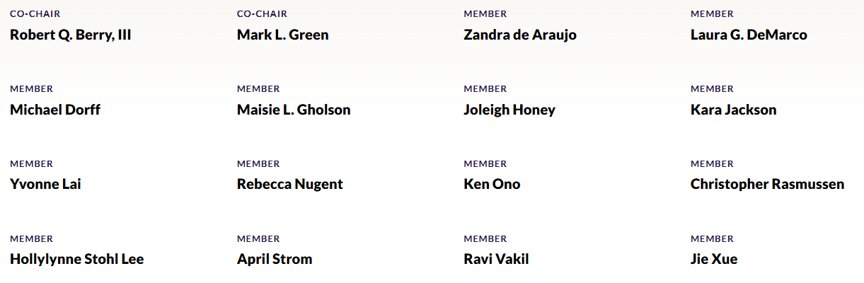
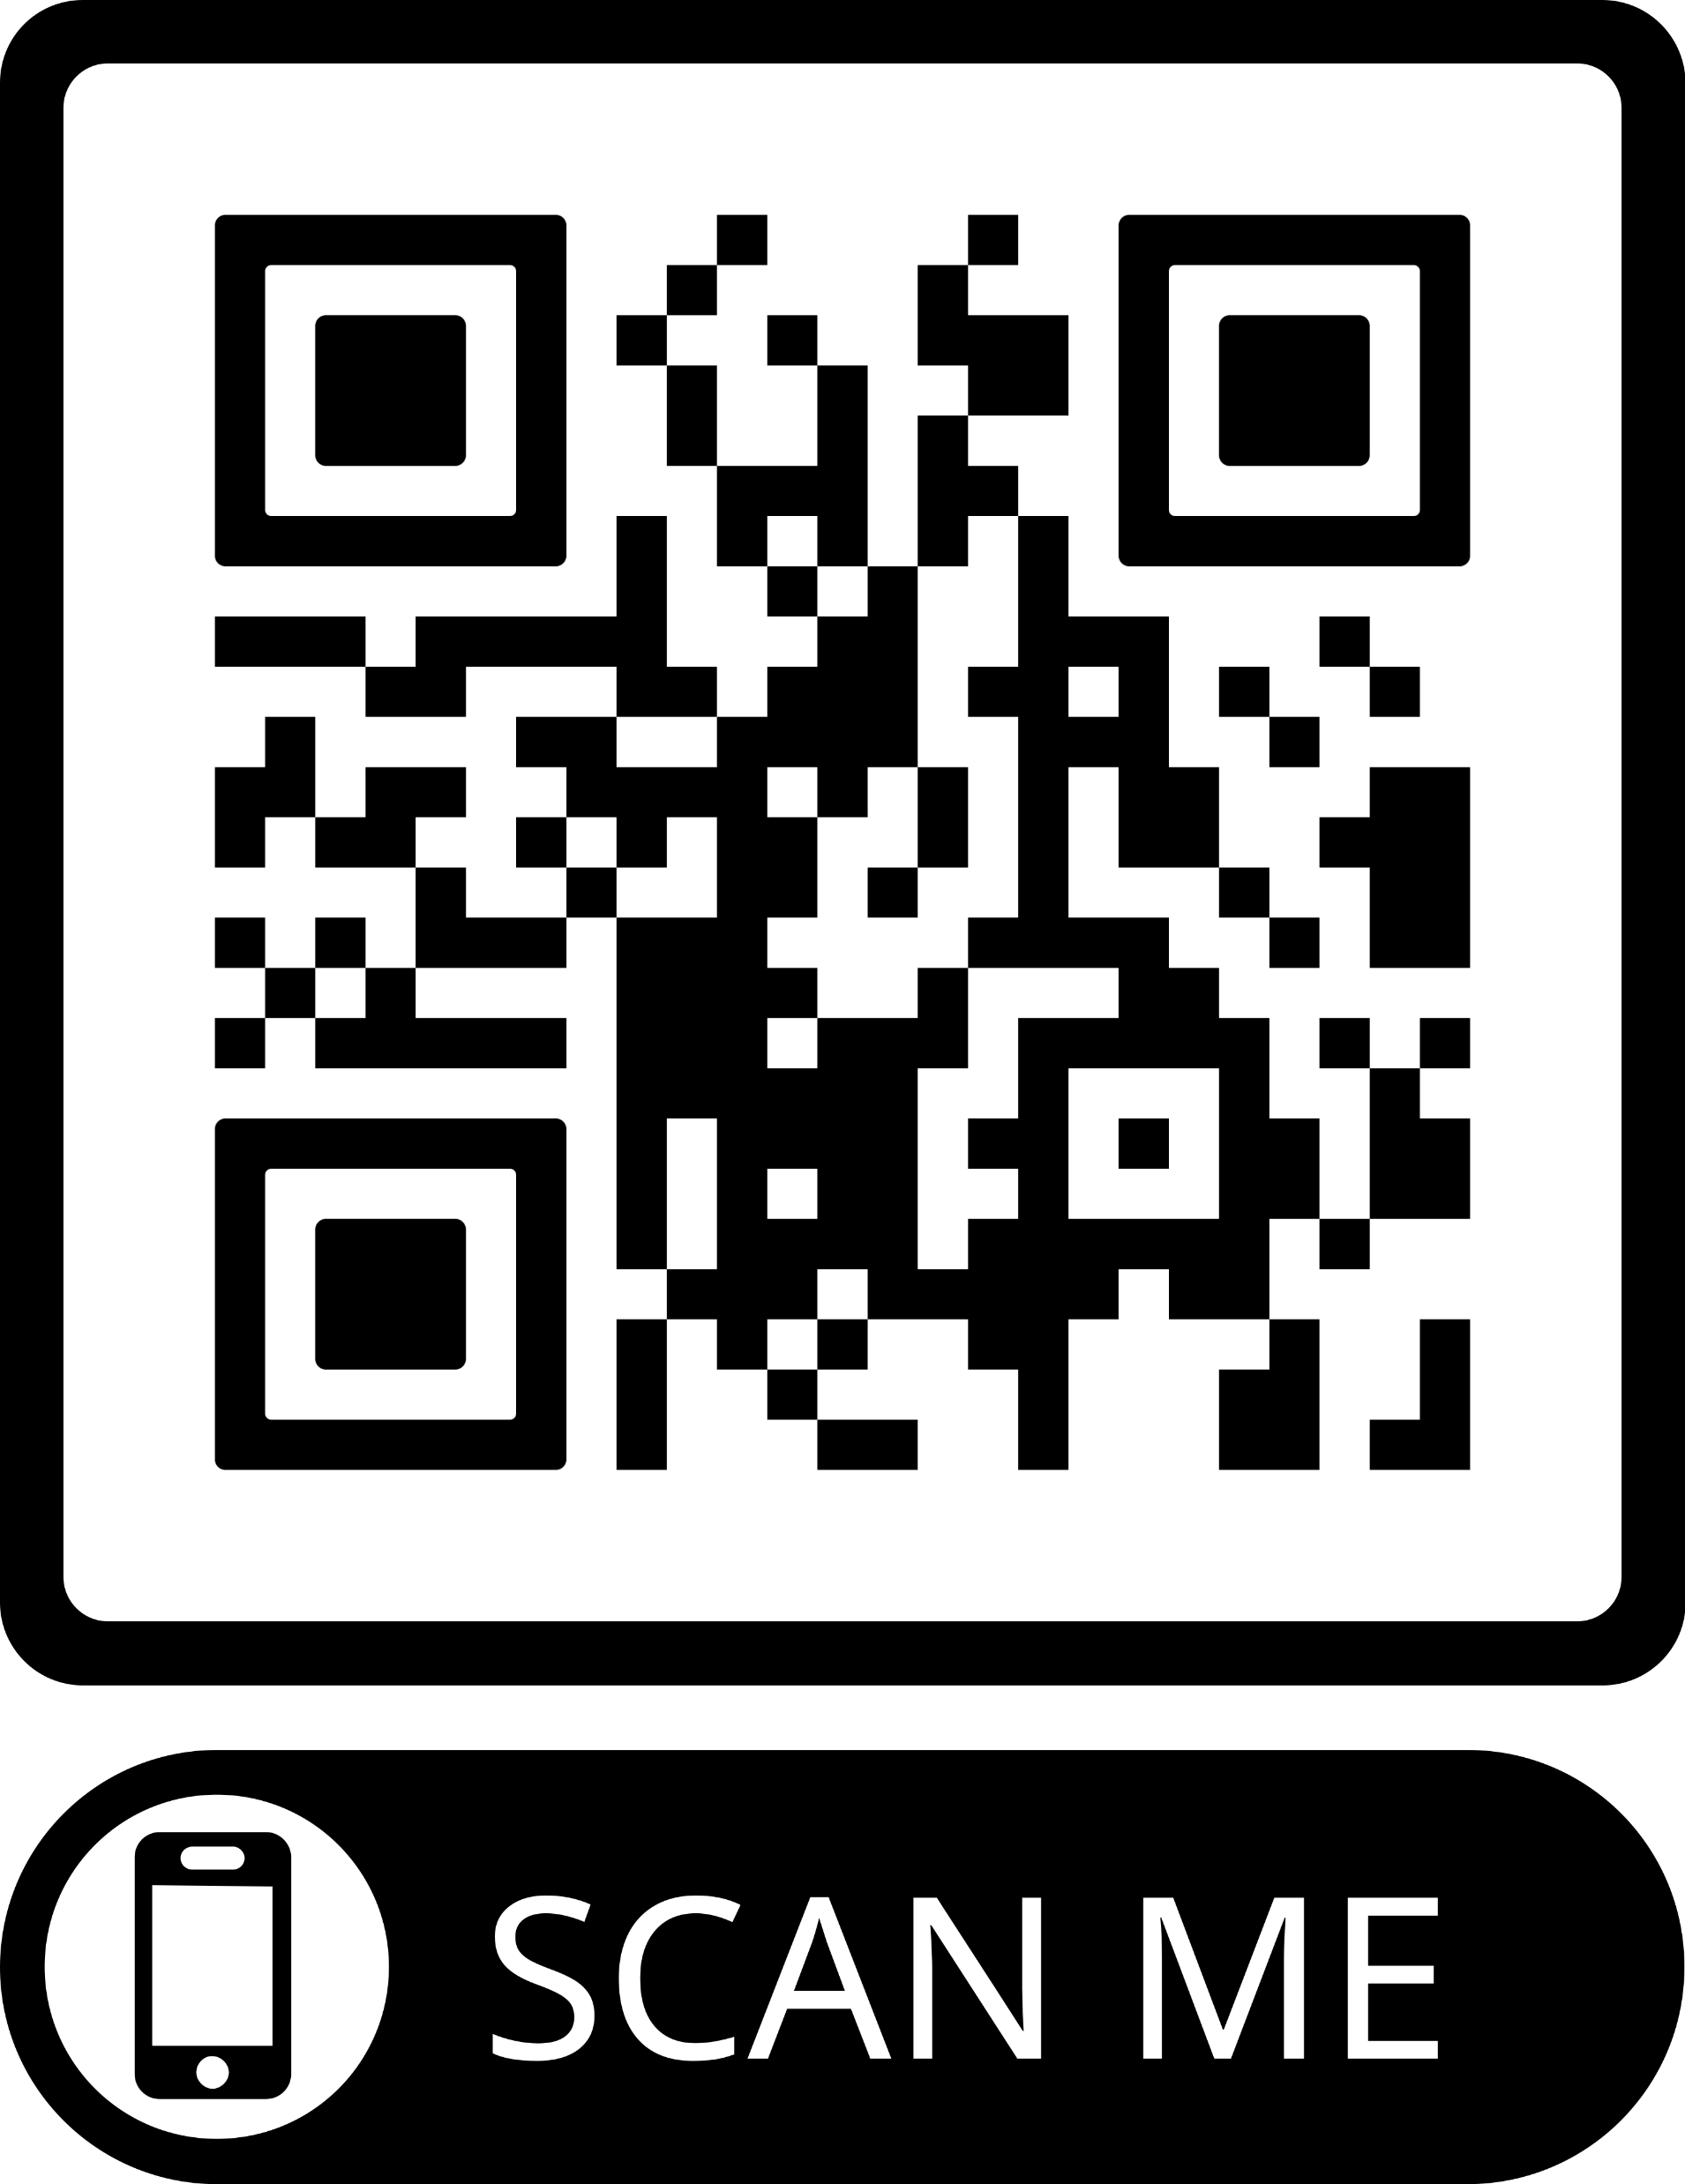
MSEB board membership
DEPSCom Meeting March 2025
Notes:
And there is a lot of interest!
We are working hard to identify the right mix of “math ed curious” mathematicians and similarly “math research interested” math educators. Much work has been done to collect evidence for specific teaching practices, including reports from the National Academies.
Once formed the board will have a potential consensus report, complete with interested sponsors, to review and adapt as they see fit. The idea for the MSEB to develop a Grades 9 -14 framework comes from the widely popular BOSE report, “A Framework for K-12 Science Education” from 2012.
Depending on how the recent actions to reduce the Education Department pan out, the MSEB may decide to step in to address some of the topics and projects that the Education Department led including highlighting the need for the NCES, examining accessibility of math ed and math research options for those with disabilities, and even step-up another NMAP.

Slide 8
MSEB: future opportunities for participation and funding
Examples of potential new studies and projects:
CBMS’s suggested consensus study: The Need for a Grades 9 -14 Mathematical and Statistical Sciences Framework
Workshops, webinars, panel discussions, other consensus studies
*** The MSEB will be seeking experts to brief the board and to serve on its committees. Sign-up to our email list to receive updates and notices.***
DEPSCom Meeting March 2025
Notes:
And there is a lot of interest!
We are working hard to identify the right mix of “math ed curious” mathematicians and similarly “math research interested” math educators. Much work has been done to collect evidence for specific teaching practices, including reports from the National Academies.
Once formed the board will have a potential consensus report, complete with interested sponsors, to review and adapt as they see fit. The idea for the MSEB to develop a Grades 9 -14 framework comes from the widely popular BOSE report, “A Framework for K-12 Science Education” from 2012.
Depending on how the recent actions to reduce the Education Department pan out, the MSEB may decide to step in to address some of the topics and projects that the Education Department led including highlighting the need for the NCES, examining accessibility of math ed and math research options for those with disabilities, and even step-up another NMAP.

Slide 9

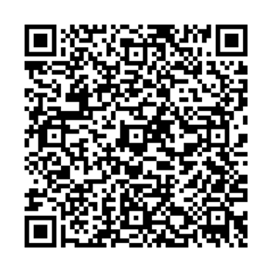
Transforming Undergraduate
STEM Education:
Supporting Equitable and Effective Teaching
https://nationalacademies.org/UG-STEM-Teaching

Slide 10
  Overview of the Charge to the Committee
  Develop a framework that articulates approaches to and guidelines for evidence-based, inclusive teaching.
      Base framework on examination of evidence, including successful efforts to improve and support instruction.
      Consider different modes of teaching (e.g., in-person, online, blended and hybrid teaching).
      Consider different educational contexts (e.g., 2-year colleges, hybrid programs, research institutions).
      Consider the roles that technology does, or can in the future, play in supporting equitable and effective teaching.
  Identify policies and practices at the departmental, programmatic, and institutional levels that can facilitate implementation of the principles in the framework.
      Examine the institutional infrastructure, policies, and practices needed to encourage and support evidence-based, equitable teaching, such as opportunities for professional development, faculty evaluation policies and practices, and reward and advancement systems.
      Discuss the experiences and training opportunities graduate students and postdoctoral students will need in order to be prepared to employ equitable and effective instruction as future faculty members.
  Provide actionable recommendations for institutions, disciplinary societies, funders, and policy makers on steps that could support implementation of the framework.
  Call out areas in need of further research.

Slide 11
  Important Tenets
Transforming the undergraduate STEM education system requires two things:
  Providing all students with the support they need to succeed, as measured by achievement of clearly communicated learning objectives.
  Supporting and rewarding all instructors by providing them with the resources they need to successfully educate all of their students.
When these two things exist, we can expect transformation. In particular:
  All students will learn and understand STEM concepts and be able to use them in practical ways.
  Most, if not all, students will have the opportunities and the resources to demonstrate their learning by meeting the desired learning objectives.
  Excellence cannot be achieved if demographic factors are predictive of academic achievement.
Notes:
Also talk here about continuous improvements. Emphasize the journey to equitable and effective teaching and how reflection and continuous improvement are key.
Throughout the report, we refer both to issues that are STEM-wide and to those that are discipline-specific or more prominent in some disciplines. Similarly, we provide examples of successful strategies and approaches that emerge from specific disciplines, many of which can be applied in others.
Regardless of whether their STEM courses contribute directly to individuals’ careers, the knowledge and skills gained have the potential to prepare all students to be knowledgeable and informed participants in their communities and societies, especially as science and technology plays an ever-increasing role in our lives.

Slide 12
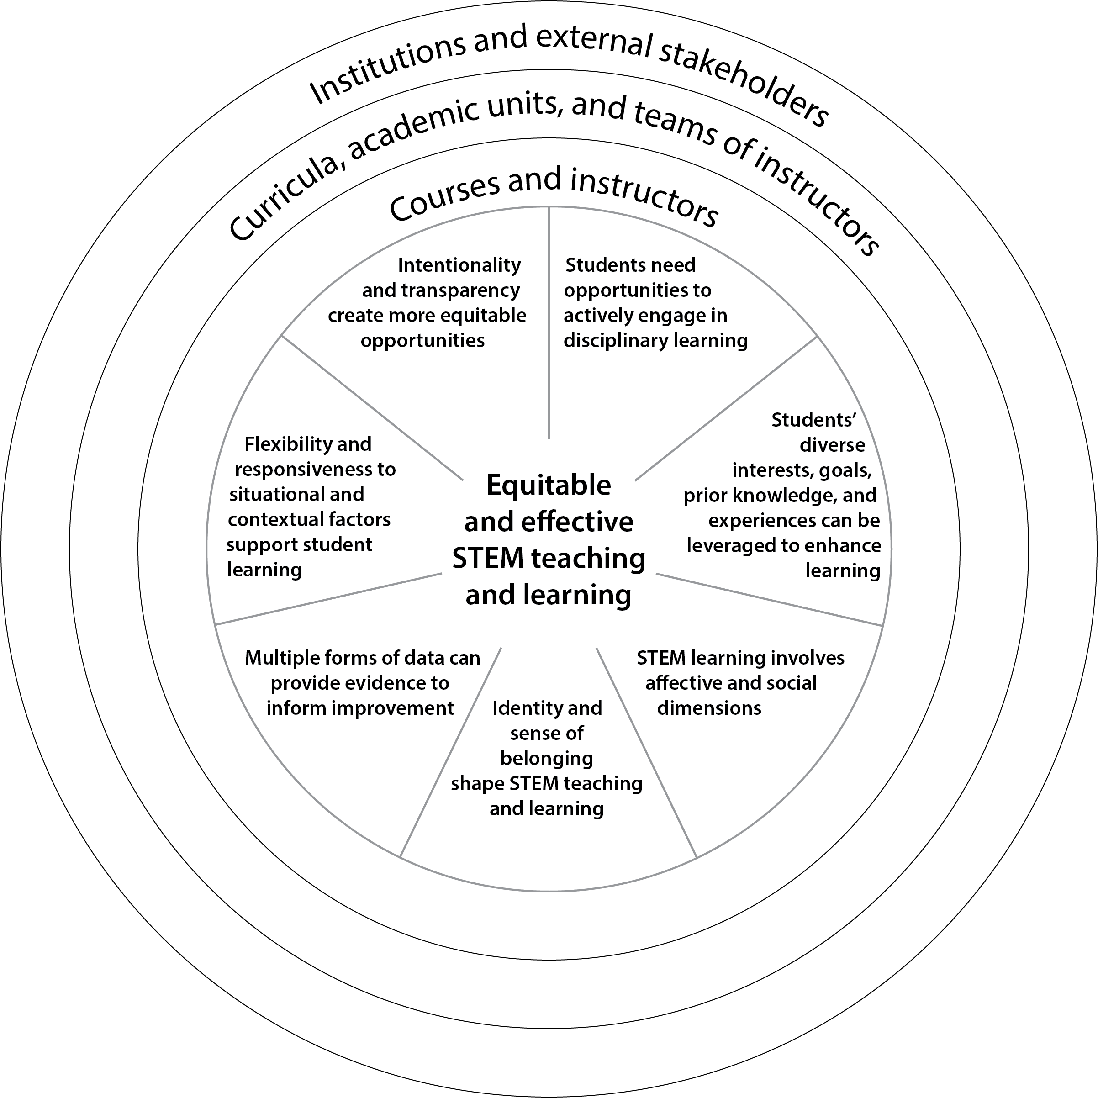
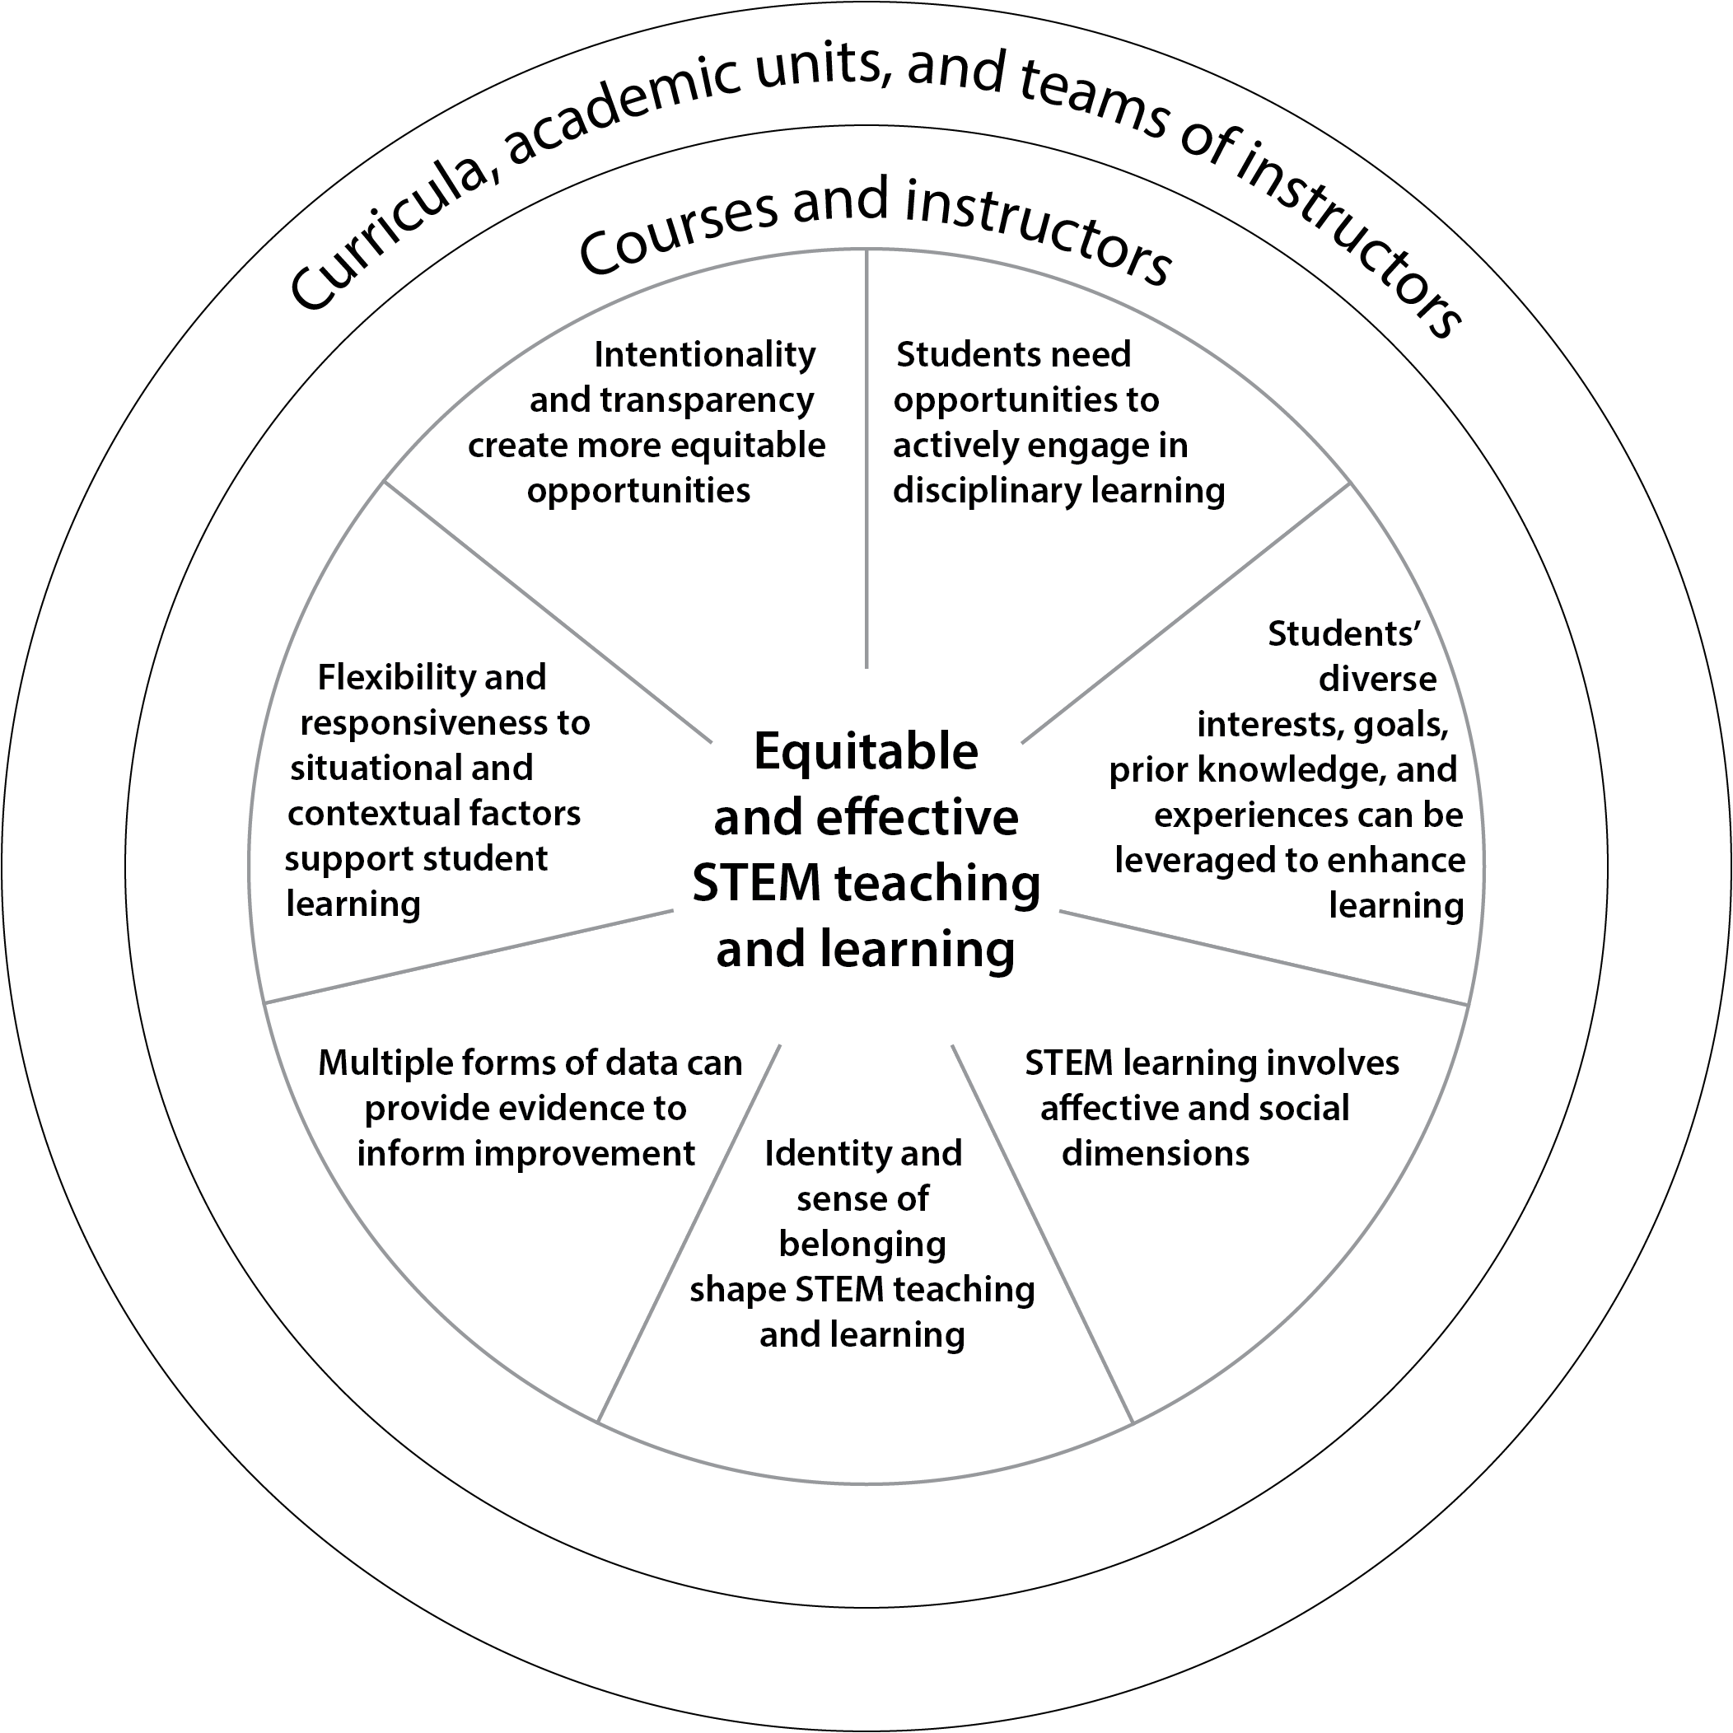
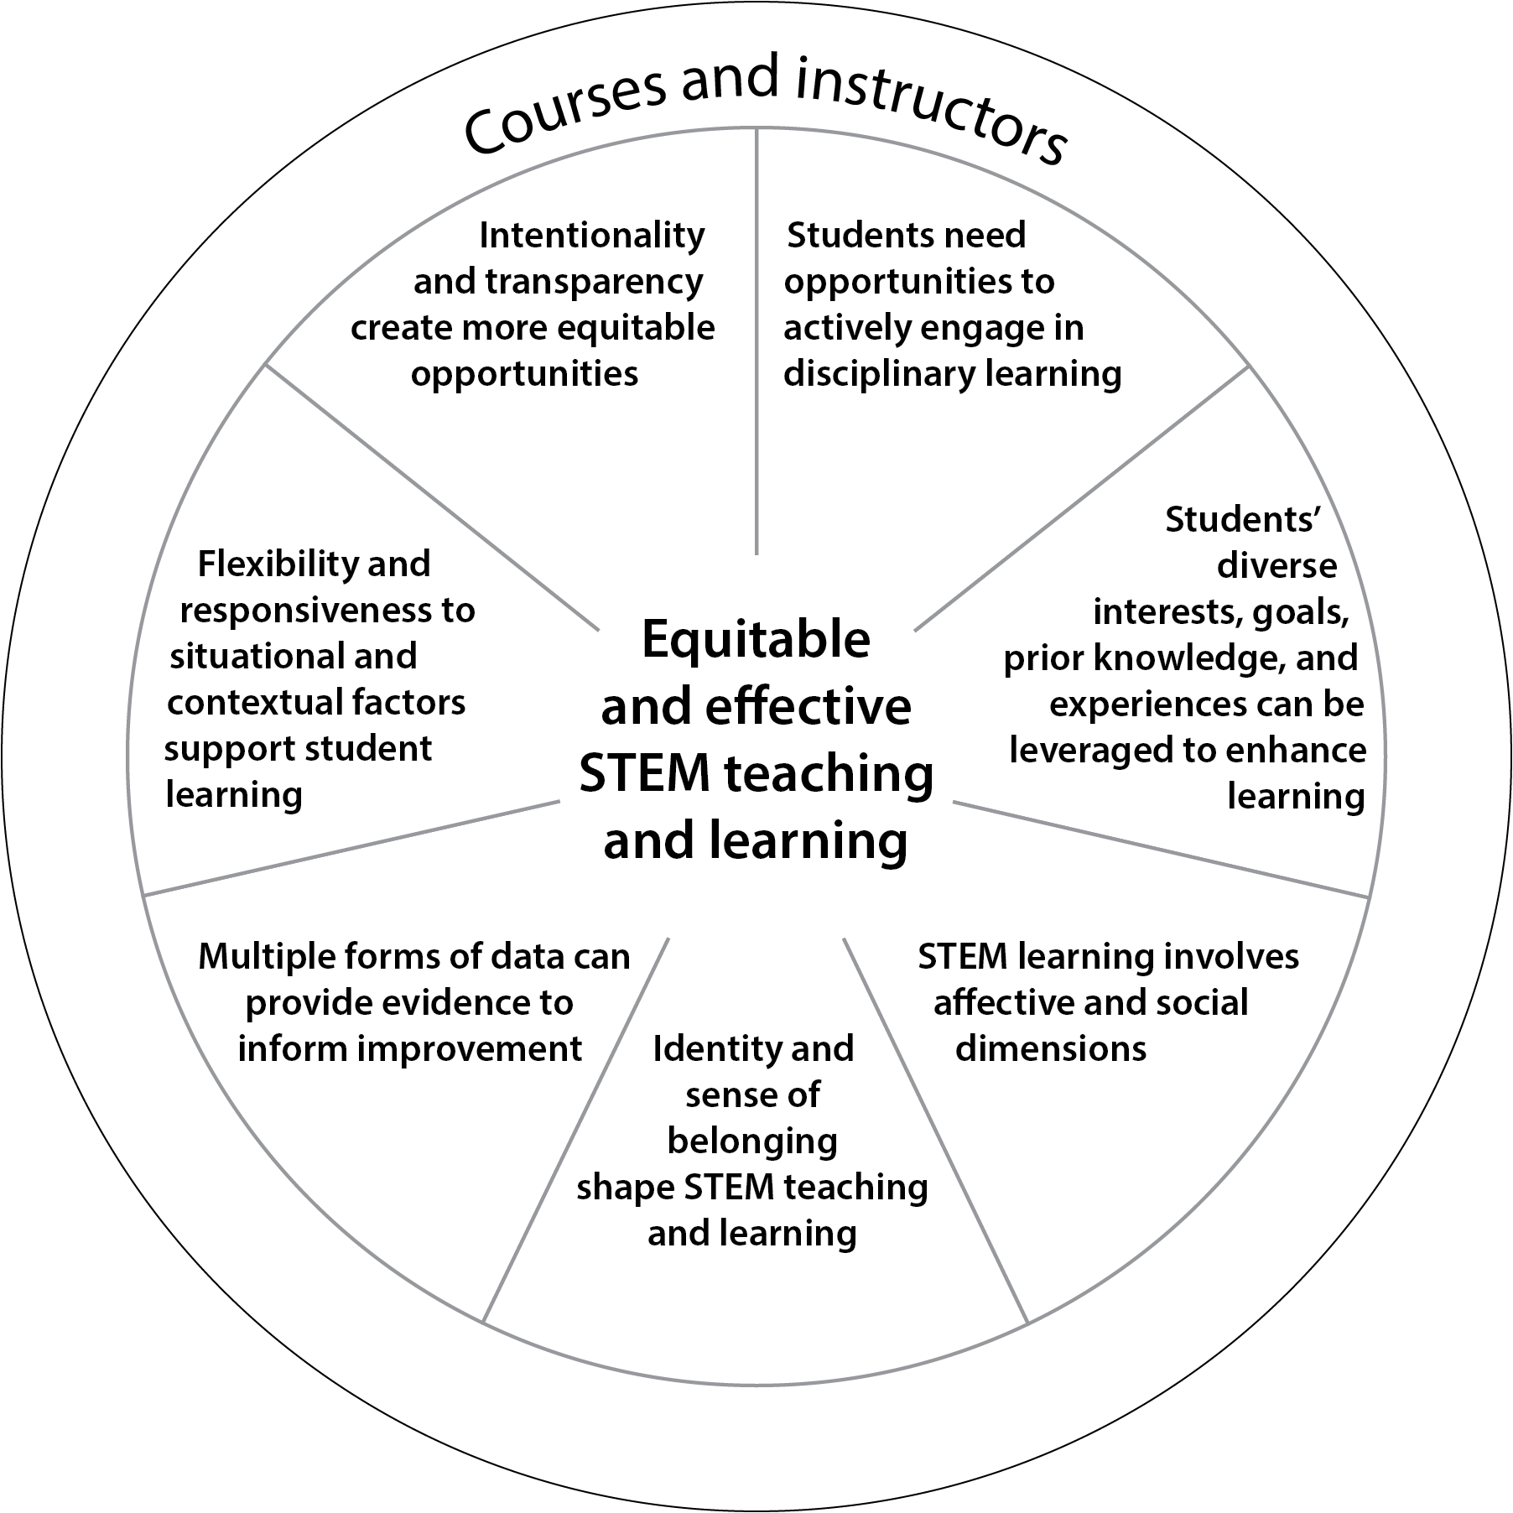
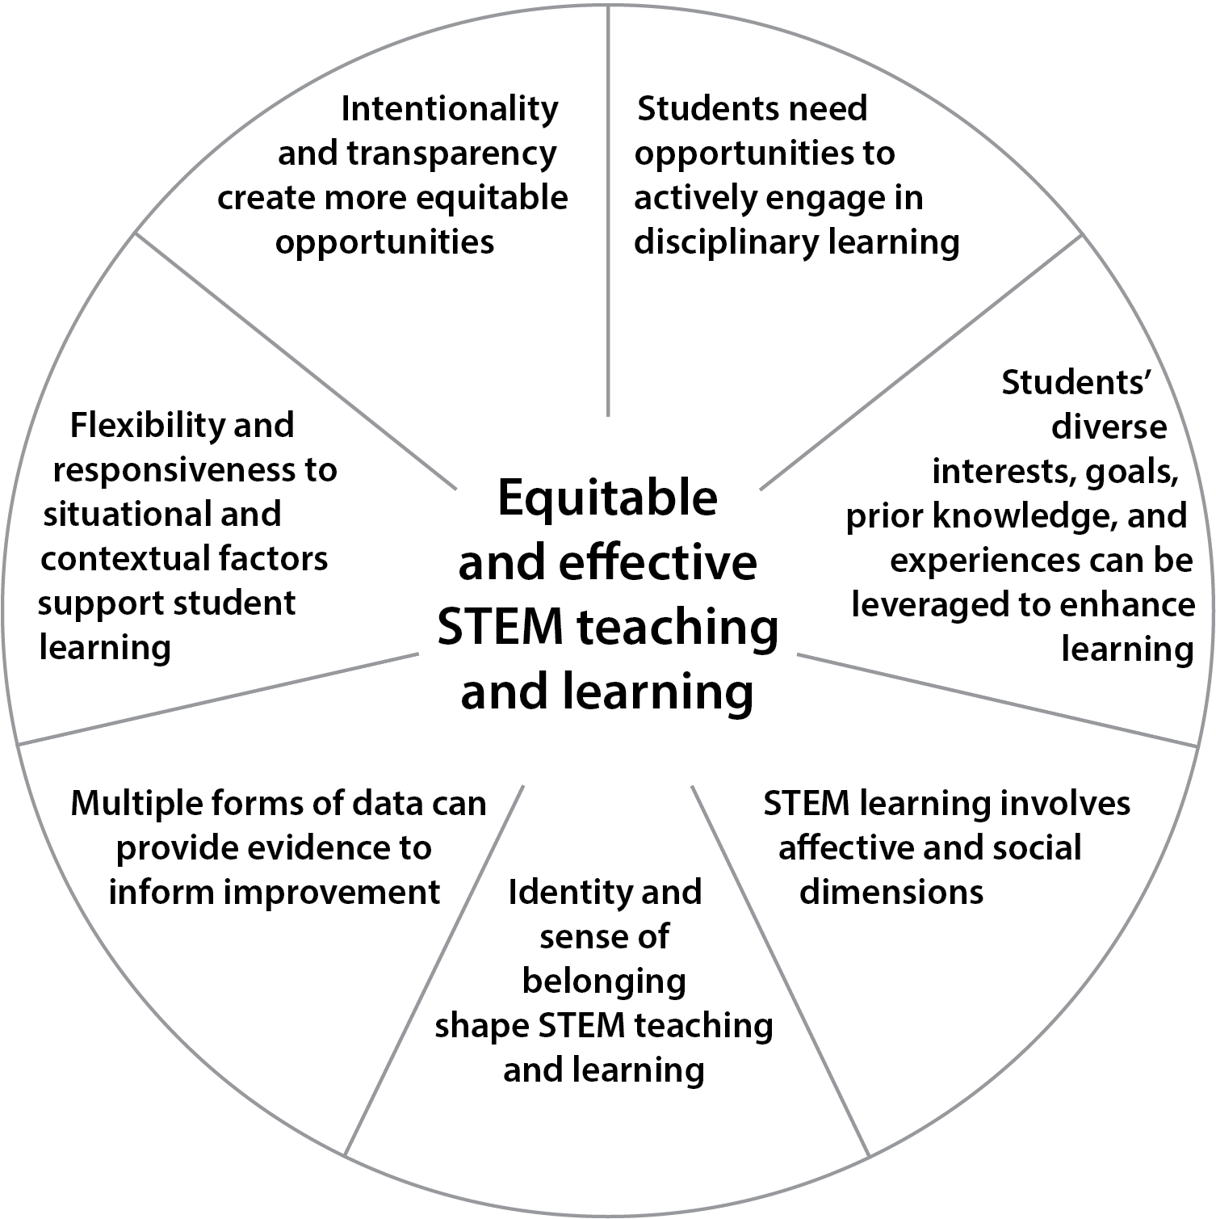
Chapters 8 & 9
Chapter 5
Chapters 6 & 7

Slide 13
Chapter 5: Using the Principles to Improve Learning Experiences
More of… | Less of…
Clear articulation of learning goals and how the work done in the course will help students achieve learning goals | A focus on getting through a set amount of content
Course structures that engage students as active learners | Course structures that maintain students as passive receivers of information
Activities that regularly engage students in using the skills and knowledge of the discipline | Separate laboratory sections focused on skills without clear connections to course content
Being transparent about opportunities and expectations for learning and engagement | Assuming that all students are aware of what they “should” be doing
Grading practices that allow for formative feedback and focus on mastery | Grading practices that focus on a theoretical distribution (a curve) and promote competition in a few high-stakes assessments
Table 5.1
Notes:
Chapter 5 is focused on instructional practices, and describes an important subset of the specific practices

Slide 14

Categories of Recommendations
Toward Equitable and Effective Learning Environments
  Recommendations 1-3
Valuing and Supporting Instructors
  Recommendations 4-10
Measuring and Advancing System Change
  Recommendations 11-15
Notes:
We should emphasize how recommendations are structured and why they are important.

Slide 15
Thank you!
The report can be read and downloaded for free from NASEM.
Use the URL or QR code to access the project page, which also has a highlights document and a link to an online interactive website.
https://nationalacademies.org/UG-STEM-Teaching

